Slide 1
Fifth Lent Talk 3rd and 4th
April 2025
Notes:
1

Slide 2
Living Hope
This Lent, in the Lay Community, we are being encouraged to put down deep roots of hope by connecting with God who is always with us. We will be doing this in several different ways, and we will be, especially, using the resources from The Church of England’s Lent theme for 2025 ‘Living Hope’ as our guide.

Slide 3
Pope Francis https://www.cbcew.org.uk/jubilee-2025-letter-from-pope-francis
‘We must fan the flame of hope that has been given us, and help everyone to gain new strength and certainty by looking to the future with an open spirit, a trusting heart and far-sighted vision. The forthcoming Jubilee can contribute greatly to restoring a climate of hope and trust as a prelude to the renewal and rebirth that we so urgently desire; that is why I have chosen as the motto of the Jubilee, Pilgrims of Hope.’

Slide 4
Booklets for adults and children and family resources:
Living Hope reflections booklets, prayer cards for adults and families are available to order now from Church House Publishing.
Reflections via email: Sign up to the Lent reflection emails and receive daily messages .These will offer Bible readings, short reflections and a practical challenge, as well as prayers linked to weekly themes.
Daily reflections via Everyday Faith app: You can read and listen to daily Lent reflections from 5th March through the Everyday Faith app, the new daily devotional app from the Church of England.

Slide 5
Lent Group Week 5 3rd/4th April
Courage
As we move into the fifth week of Lent, we explore that when we can trust God and put our hope in him, this can give us the courage to seek change where it is needed. Rooted in the hopeful future God offers us, we dare to reimagine the present.

Slide 6
Opening Prayer
Crucified God, you call each one of us to take up our crosses and follow you. As we do this day by day, we ask that you would nurture within each one of us a spirit of courage that will enable us to walk our own cross shaped paths. In the face of apparent hopelessness, despair and pain, we pray that we will always remember that we are an Easter people. An alleluia people whose words and actions, both big and small, are harbingers of the coming Kingdom of God. Amen.

Slide 7
Reading: Luke 9:23-27
Then he said to them all, ‘If any want to become my followers, let them deny themselves and take up their cross daily and follow me. For those who want to save their life will lose it, and those who lose their life for my sake will save it. What does it profit them if they gain the whole world, but lose or forfeit themselves? Those who are ashamed of me and of my words, of them the Son of Man will be ashamed when he comes in his glory and the glory of the Father and of the holy angels. But truly I tell you, there are some standing here who will not taste death before they see the kingdom of God.”

Slide 9
Further Quotes for Reflection
"God, grant me the serenity to accept the things I cannot change, courage to change the things I can, and wisdom to know the difference."

Slide 10
Further Quotes for Reflection – Etty Hillesum

Slide 11
Questions for Discussion
What struck you from the reflections you read over the past week? Did you try any of the challenges from the resources? If you did, is there anything you noticed?
Have there been times in your spiritual life where you have needed to be courageous? What did that feel like?
Do you think people like Etty are unique human beings or do you believe that each of one of us can choose beauty, worth and meaning in the face of apparent hopelessness?
In what ways do you sense God might be calling you, or his people, to such lives of courage at this juncture in human history? What might this look like?
In the Rule of St Benedict, St. Benedict writes: "The fourth degree of humility is that one holds fast to patience with a quiet mind when facing difficulties, contradictions, and even injustice in the course of obedience, enduring all without growing weary or running away. For Scripture says, 'Those who persevere to the end will be saved' (Matt. 10:22); and again, 'Let your heart take courage, and wait for the Lord' (Ps. 27:14).” How do you think St. Benedict understands the nature of courage here, and how might it be helpful to us in our spiritual journeys?

Slide 13
Silent Prayer
A space where we can briefly drop into the silence the name of any people, situations, or places where God’s hope, God’s Yes, is needed at this time
Please un-mute to share your word or phrase aloud.
Be mindful this is a public place, and only share others’ personal information if you have their consent to do so in a public setting.

Slide 14
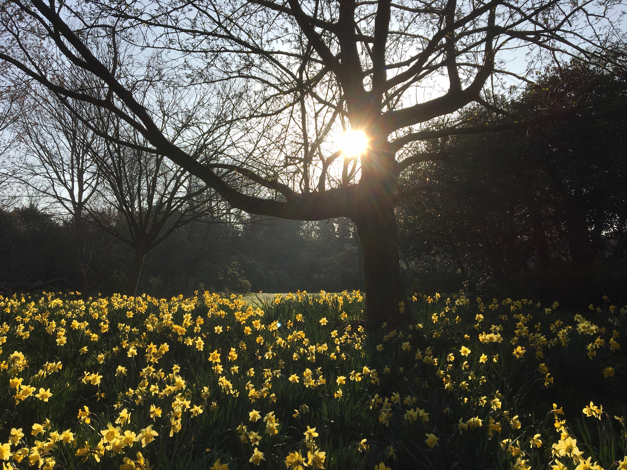
Closing Prayer
May the grace of our Lord Jesus Christ, and the love of God, and the fellowship of the Holy Spirit be with us all, now and evermore. Amen.

