Slide 1
Second Lent Talk 13th and 14th March 2025
Notes:
1

Slide 2
Living Hope
This Lent, in the Lay Community, we are being encouraged to put down deep roots of hope by connecting with God who is always with us. We will be doing this in several different ways, and we will be, especially, using the resources from The Church of England’s Lent theme for 2025 ‘Living Hope’ as our guide.

Slide 3
Pope Francis https://www.cbcew.org.uk/jubilee-2025-letter-from-pope-francis
‘We must fan the flame of hope that has been given us, and help everyone to gain new strength and certainty by looking to the future with an open spirit, a trusting heart and far-sighted vision. The forthcoming Jubilee can contribute greatly to restoring a climate of hope and trust as a prelude to the renewal and rebirth that we so urgently desire; that is why I have chosen as the motto of the Jubilee, Pilgrims of Hope.’

Slide 4
Booklets for adults and children and family resources:
Living Hope reflections booklets, prayer cards for adults and families are available to order now from Church House Publishing.
Reflections via email: Sign up to the Lent reflection emails and receive daily messages .These will offer Bible readings, short reflections and a practical challenge, as well as prayers linked to weekly themes.
Daily reflections via Everyday Faith app: You can read and listen to daily Lent reflections from 5th March through the Everyday Faith app, the new daily devotional app from the Church of England.

Slide 5
Lent Group Week 2 13th/14th March
Trusting
In this second week of Lent, we’re going to think through how much trust it takes to have hope.
How can we have hope, even when it’s tough? Even when we can’t make sense of what God is up to?

Slide 6
Opening Prayer
Pilgrim God, as we make our Lenten journey, we ask you would birth within each one of us a spirit of trust. Trust that even in the darkest of tombs, in the places of woundedness and seeming hopelessness, that you are always calling forth hope-giving life. Help each one of us to hear you calling forth such a life within us, so that we might be heralds, in words and action, of your eternal springtime this day and all days. Amen.

Slide 8
Reading: John 11:17-27
When Jesus arrived, he found that Lazarus had already been in the tomb for four days.
Now Bethany was near Jerusalem, some two miles away, and many of the Jews had come to Martha and Mary to console them about their brother. When Martha heard that Jesus was coming, she went and met him, while Mary stayed at home. Martha said to Jesus, ‘Lord, if you had been here, my brother would not have died. But even now I know that God will give you whatever you ask of him.
’ Jesus said to her, ‘Your brother will rise again. ’
Martha said to him, ‘I know that he will rise again in the resurrection on the last day.
’ Jesus said to her, ‘I am the resurrection and the life. Those who believe in me, even though they die, will live, and everyone who lives and believes in me will never die. Do you believe this?’
She said to him,
‘Yes, Lord, I believe that you are the Messiah, the Son of God, the one coming into the world ‘

Slide 9
Quotes for Further Reflection
From Wild Bright Hope: ‘Christian hope is not just the redemption of brokenness, it is redemption through brokenness. Christ’s body was broken for us, and it is through that brokenness that we are redeemed. When he appeared to the apostles, Christ retained the holes in his hands and the piercing in his side. The scars that remain by painful repair are the perpetual testimony that wounds can heal! ’Cameron Howe (p53)‘
‘Hope does not guarantee a particular outcome. Nor does it somehow enable us to endure, unfeeling, until Jesus returns. Instead, hope in a future secure with God gives us a different perspective on the present.’ Martha Jarvis (p63)

Slide 11
Questions for Discussion
What struck you from the reflections you read over the past week?
Did you try any of the challenges from the resources? If you did, is there anything you noticed?
In what situations do you find it hard to trust God? Where is hope hard to find?
St. Benedict called his monks to a life of obedience ( a word etymologically in Latin related to listening), what might God be wanting you to hear in such situations?
What do you make of the idea that hope can sit alongside confusion and desperation?
How do you feel about expressing uncomfortable emotions to God?

Slide 12
Silent Prayer
A space where we can briefly drop into the silence the name of any people, situations, or places where God’s hope, God’s Yes, is needed at this time
Please un-mute to share your word or phrase aloud.
Be mindful this is a public place, and only share others’ personal information if you have their consent to do so in a public setting.

Slide 13
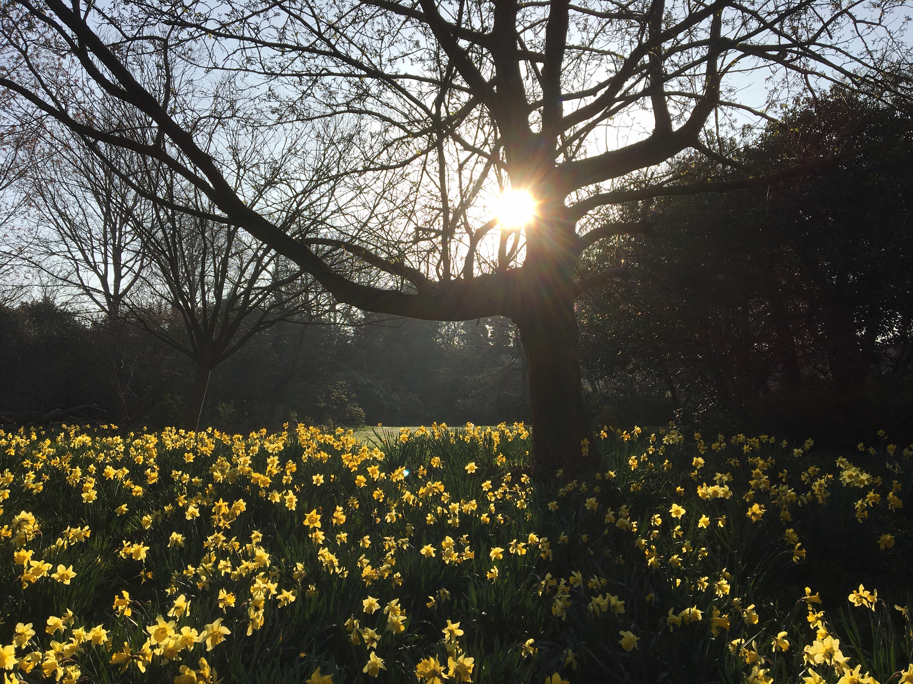
Closing Prayer
May the grace of our Lord Jesus Christ, and the love of God, and the fellowship of the Holy Spirit be with us all, now and evermore. Amen.

