Slide 1
First Lent Talk 6th and 7th March 2025
Notes:
1

Slide 2
Living Hope
This Lent, in the Lay Community, we are being encouraged to put down deep roots of hope by connecting with God who is always with us. We will be doing this in several different ways, and we will be, especially, using the resources from The Church of England’s Lent theme for 2025 ‘Living Hope’ as our guide.

Slide 3
Pope Francis https://www.cbcew.org.uk/jubilee-2025-letter-from-pope-francis
‘We must fan the flame of hope that has been given us, and help everyone to gain new strength and certainty by looking to the future with an open spirit, a trusting heart and far-sighted vision. The forthcoming Jubilee can contribute greatly to restoring a climate of hope and trust as a prelude to the renewal and rebirth that we so urgently desire; that is why I have chosen as the motto of the Jubilee, Pilgrims of Hope.’

Slide 4
Booklets for adults and children and family resources:
Living Hope reflections booklets, prayer cards for adults and families are available to order now from Church House Publishing.
Reflections via email: Sign up to the Lent reflection emails and receive daily messages .These will offer Bible readings, short reflections and a practical challenge, as well as prayers linked to weekly themes.
Daily reflections via Everyday Faith app: You can read and listen to daily Lent reflections from 5th March through the Everyday Faith app, the new daily devotional app from the Church of England.

Slide 5
Lent Group Week 1 6/7 March
What is hope? – Exploring what hope means in the context of the Christian faith.
Imperfect – Exploring how we hold on to hope in lives that are messy and in a world that is imperfect

Slide 6
Opening Prayer
Hope giving God, we, your pilgrim people, hold before you all of our longings for growth and renewal in this Lenten season. May our words and actions this day, and all days, be portals of your Jubilee reign, doorways for a coming Kingdom of Easter love that will enliven and renew both humanity and the whole face of the earth. Amen.

Slide 8
Romans 5.1-8
Therefore, since we are justified by faith, we have peace with God through our Lord Jesus Christ, through whom we have obtained access to this grace in which we stand; and we boast in our hope of sharing the glory of God. And not only that, but we also boast in our sufferings, knowing that suffering produces endurance, and endurance produces character, and character produces hope, and hope does not disappoint us, because God’s love has been poured into our hearts through the Holy Spirit that has been given to us. For while we were still weak, at the right time Christ died for the ungodly. Indeed, rarely will anyone die for a righteous person — though perhaps for a good person someone might actually dare to die. But God proves his love for us in that while we still were sinners Christ died for us.

Slide 9
Romans 7.15-19, 24-25
I do not understand my own actions. For I do not do what I want, but I do the very thing I hate. Now if I do what I do not want, I agree that the law is good. But in fact it is no longer
I that do it, but sin that dwells within me. For I know that nothing good dwells within me, that is, in my flesh. I can will what is right, but I cannot do it. For I do not do the good I want, but the evil I do not want is what I do. Wretched man that I am! Who will rescue me from this body of death? Thanks be to God through Jesus Christ our Lord! So then, with my mind I am a slave to the law of God, but with my flesh I am a slave to the law of sin.

Slide 11
Questions for Discussion
How does the idea of hope speak to your life at the moment?
How would you describe ‘hope’? How is it different from optimism?
What are some of the limitations and frustrations you encounter in your everyday life?
In Chapter 57 of the rule, Benedict writes: "If there are workmen in the monastery, they are to practise their craft with all humility." What might this teach us about embracing our limitations and imperfections?
How does God offer hope to you in situations of limitation and imperfection?

Slide 12
Cameron Howe Wild Bright Hope: A Lent Journey page 53
Christian hope is not just the redemption of brokenness, it is redemption through brokenness. Christ’s body was broken for us, and it is through that brokenness that we are redeemed. When he appeared to the apostles, Christ retained the holes in his hands and the piercing in his side. The scars that remain by painful repair are the perpetual testimony that wounds can heal!

Slide 13
Martha Jarvis Wild Bright Hope page 63
Hope does not guarantee a particular outcome. Nor does it somehow enable us to endure, unfeeling, until Jesus returns. Instead, hope in a future secure with God gives us a different perspective on the present.

Slide 14
Silent Prayer
A space where we can briefly drop into the silence the name of any people, situations, or places where God’s hope, God’s Yes, is needed at this time
Please un-mute to share your word or phrase aloud.
Be mindful this is a public place, and only share others’ personal information if you have their consent to do so in a public setting.

Slide 15
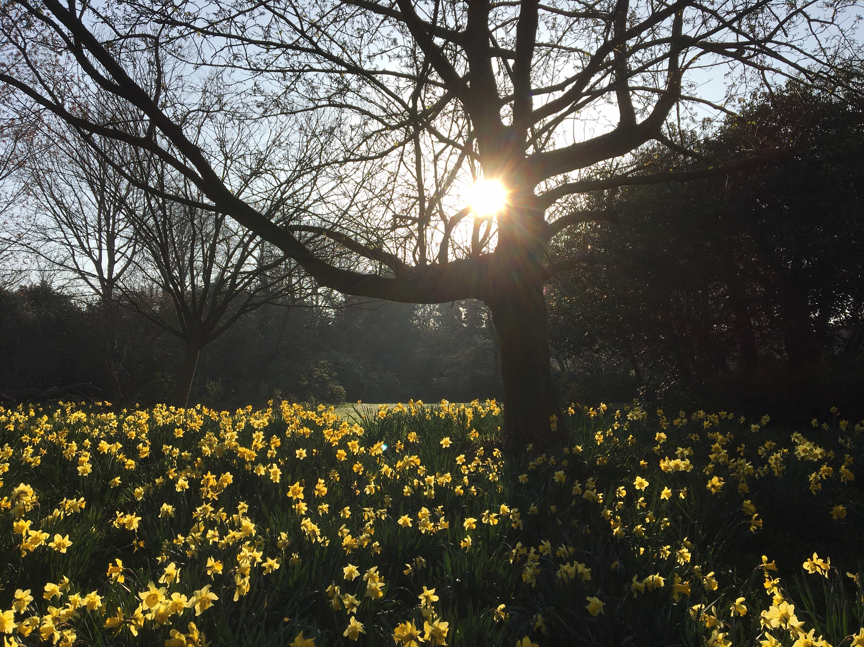
Closing Prayer
May the grace of our Lord Jesus Christ, and the love of God, and the fellowship of the Holy Spirit be with us all, now and evermore. Amen.

