Slide 1
Fourth Lent Talk 28th and 29th March 2025
Notes:
1

Slide 2
Living Hope
This Lent, in the Lay Community, we are being encouraged to put down deep roots of hope by connecting with God who is always with us. We will be doing this in several different ways, and we will be, especially, using the resources from The Church of England’s Lent theme for 2025 ‘Living Hope’ as our guide.

Slide 3
Pope Francis https://www.cbcew.org.uk/jubilee-2025-letter-from-pope-francis
‘We must fan the flame of hope that has been given us, and help everyone to gain new strength and certainty by looking to the future with an open spirit, a trusting heart and far-sighted vision. The forthcoming Jubilee can contribute greatly to restoring a climate of hope and trust as a prelude to the renewal and rebirth that we so urgently desire; that is why I have chosen as the motto of the Jubilee, Pilgrims of Hope.’

Slide 4
Booklets for adults and children and family resources:
Living Hope reflections booklets, prayer cards for adults and families are available to order now from Church House Publishing.
Reflections via email: Sign up to the Lent reflection emails and receive daily messages .These will offer Bible readings, short reflections and a practical challenge, as well as prayers linked to weekly themes.
Daily reflections via Everyday Faith app: You can read and listen to daily Lent reflections from 5th March through the Everyday Faith app, the new daily devotional app from the Church of England.

Slide 5
Lent Group Week 3 28th/29th March
Noticing
As we move into the fourth week of Lent, we are tasking ourselves with the art of noticing.
Noticing what God is doing in our lives, our communities, our world.

Slide 6
Opening Prayer
Creating God, God of all of our becomings, open our eyes to notice you working in each moment of our lives. May we glimpse you opening gateways to heaven in the myriad of activities that occupy our daily lives. As we continue our Lenten journey, stretch out our hands to embrace your world, so that we might consecrate with you every moment, bringing Easter hope wherever there is despair, and life-giving love to all whom we meet this day, and all days. Amen.

Slide 7
Reading: Genesis 28:10-17
Jacob left Beer-sheba and went towards Haran. He came to a certain place and stayed there for the night, because the sun had set. Taking one of the stones of the place, he put it under his head and lay down in that place. And he dreamed that there was a ladder set up on the earth, the top of it reaching to heaven; and the angels of God were ascending and descending on it. And the Lord stood beside him and said,
‘I am the Lord, the God of Abraham your father and the God of Isaac; the land on which you lie I will give to you and to your offspring; and your offspring shall be like the dust of the earth, and you shall spread abroad to the west and to the east and to the north and to the south; and all the families of
the earth shall be blessed in you and in your offspring. Know that I am with you and will keep you wherever you go, and will bring you back to this land; for I will not leave you until I have done what I have promised you.’ Then Jacob woke from his sleep and said, ‘Surely the Lord is in this place—and I did not know it!’ And he was afraid, and said, ‘How awesome is
this place! This is none other than the house of God, and this is the gate of heaven.’

Slide 9
Further Quotes for Reflection
Belle writes: ‘It’s possible to miss God. It’s possible for him to have been up to something, right before our eyes, and we didn’t spot it. How interesting is that? God is always doing things that we can’t see but it’s worth remembering that sometimes he gives us glimpses. However, noticing them isn’t inevitable. ’ (p58, Living Hope)

Slide 10
Further Quotes for Reflection
‘Hope starts by living it, in whichever context and daily life is ours. Then, in humility and
assurance, we can offer them as gifts to the world. ’ Hannah Spiers(p122)
‘Our great and gracious God is up to something beautiful in this cultural moment, I’m certain of it. The evidence is all over the place. ’ Belle Tindall (p131)

Slide 11
Questions for Discussion
What struck you from the reflections you read over the past week? Did you try any of the challenges from the resources? If you did, is there anything you noticed?
Where do you mainly, for good or ill, put your attention?
What would it feel like to slow down a little bit more, to notice more, to notice something of the ’sacrament of the present moment’?
In the Rule of St. Benedict, there is an emphasis on finding God in the ordinary tasks and rhythms of daily life. How might you transform a routine activity in your day (like washing dishes, walking between buildings, or engaging with challenging community members) into a moment of sacred noticing?
Where might God be asking you to notice Him at work in places where up to now you have struggled to see his ‘fingerprints’? What are the obstacles to you consecrating these places in your life?

Slide 13
Silent Prayer
A space where we can briefly drop into the silence the name of any people, situations, or places where God’s hope, God’s Yes, is needed at this time
Please un-mute to share your word or phrase aloud.
Be mindful this is a public place, and only share others’ personal information if you have their consent to do so in a public setting.

Slide 14
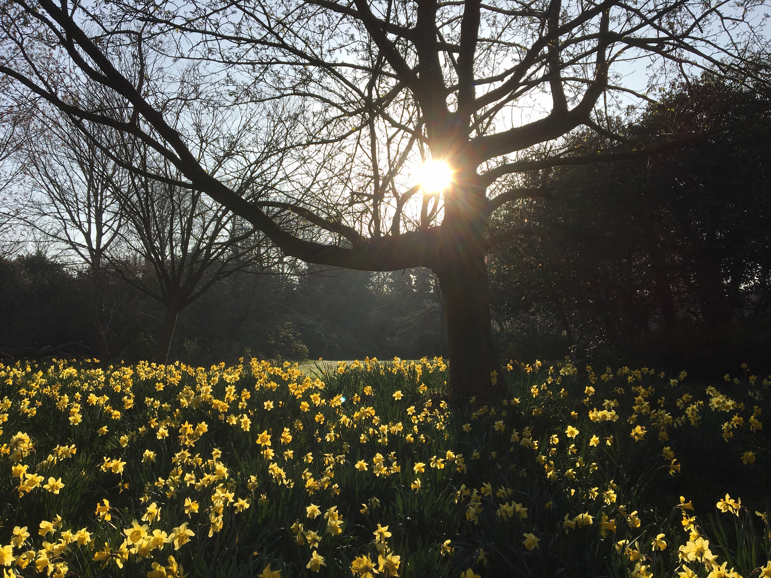
Closing Prayer
May the grace of our Lord Jesus Christ, and the love of God, and the fellowship of the Holy Spirit be with us all, now and evermore. Amen.

